Slide 1

NFL Play Call Prediction Using Sequential Neural Networks
Joseph Director
MS Statistics
Master’s Project

Slide 2
Abstract
Over the last 20 years, the use of analytics in professional sports has gone from fringes to mainstream
One application is tendency analysis in football: play call prediction
Supervised machine learning has been used to map available features to play calls (run or pass)
However, treating play calls as sequential has been proposed, but not adopted
This work compares the predictive performance of sequential models (RNN and LSTM Neural Networks) to baseline approaches (Logistic Regression and Gradient Boosted Decision Trees)

Slide 3

Background – Domain Context
Gameplay is done in a sequence of instances (plays) each with a binary outcome (run or pass)
Between plays, offensive and defensive teams reposition and strategize
Strategy is guided by the predicted course of action the opposition will take
Significant competitive advantage gained by accurate predictions
Several factors influence play call decisions:
Formation and personnel groups
In game context
Historical tendencies

Slide 4
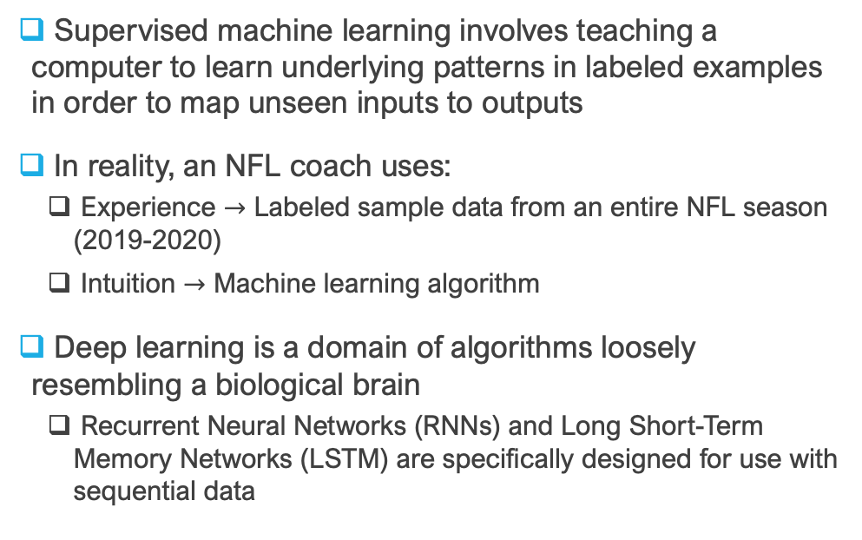
Background – Machine Learning
Supervised machine learning involves teaching a computer to learn underlying patterns in labeled examples in order to map unseen inputs to outputs
In reality, an NFL coach uses:
Experience $→$ Labeled sample data from an entire NFL season (2019-2020)
Intuition $→$ Machine learning algorithm
Deep learning is a domain of algorithms loosely resembling a biological brain
Recurrent Neural Networks (RNNs) and Long Short-Term Memory Networks (LSTM) are specifically designed for use with sequential data

Slide 5


Motivation
Prior studies have implemented machine learning methods for play call prediction
Minimal performance increase when adding complexity to model strategy
Treated each singular play call as an observation
Performance increase requires rethinking how the data is structured
Treat each sample observation as a sequence of play calls of length $k$
Allow model to pick up on sequential patterns inherent in the data

Slide 6

Problem Statement
Using the measures of prediction accuracy and class separability on unseen data, can sequential models outperform baseline approaches?
Find necessary level of complexity required for any given modeling approach
Determine ideal play call sequence length for sequential models
Test if best model can perform in important game situations

Slide 7
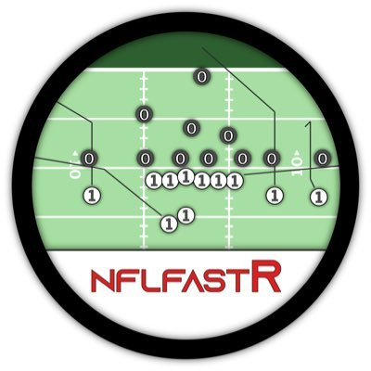

Available Data
nflfastR provides abundant play by play data so no web-scraping is required during preprocessing
A single NFL season was chosen (2019) for team consistency ~ 32,000 play call observations
Tabular data is shape $(N,m)$ with $N$ samples and $m$ features
Sequential data is shape $\left(N, k, m\right)$ where $k$ is the sequence length

Slide 8
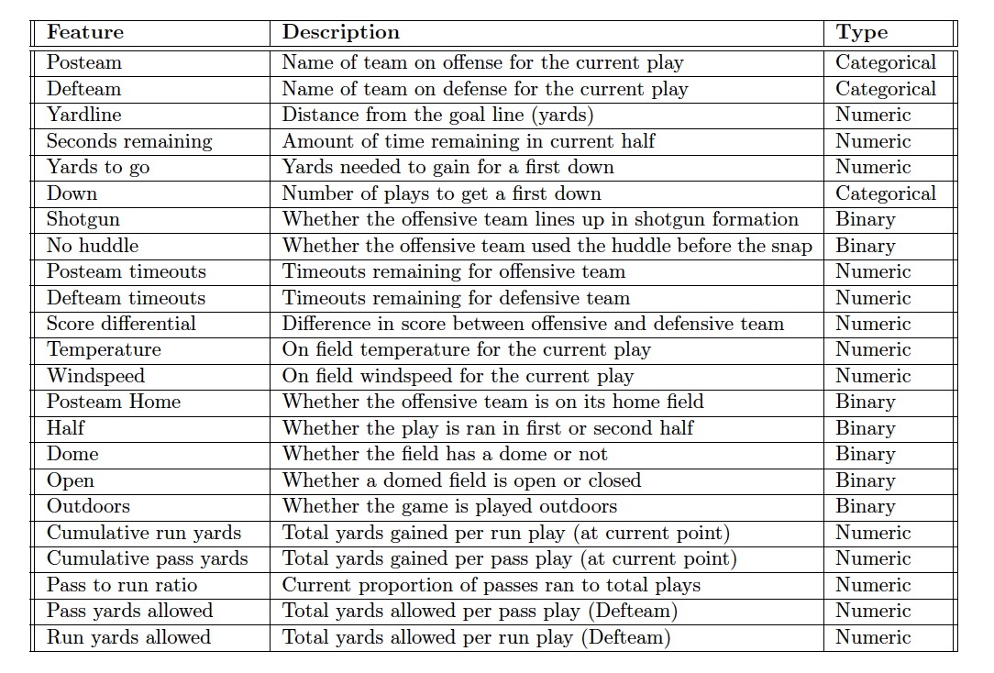
Features
Choice of features designed to reflect information available at time of play call
Some features are directly available from nflfastR
Others are gained through feature engineering

Slide 9

Overall Methodological Workflow
Sequential Models
RNN
LSTM
Data Preprocess
Cross- Validation Splitting
Sample Data
Performance Evaluation
Baseline Models
Log Regr
nflfastR
Tabular Data
Test
GBDT
Val
Train

Slide 10

Data Preprocessing
Filter data to only include desired observations
Only retain regular season
No “special teams” plays (kick-offs, punts, field goals) or penalties
QB scrambles count as passes
Handle missing values for games inside domes
Set temperature to 72℉ and 0 windspeed
One-hot encode binary and categorical features

Slide 11

Feature Engineering
Build cumulative tendencies into data
Designed to reflect current information at the time of a given play call
Cumulative pass to run ratio:
Group data by offensive team
Calculate running total of passes over total plays
Cumulative yards per play type:
Group data by offensive team
Calculate running total of yards gained (for each play type) per play
Cumulative yards allowed per play type:
Perform above calculation instead grouping by defensive team

Slide 12
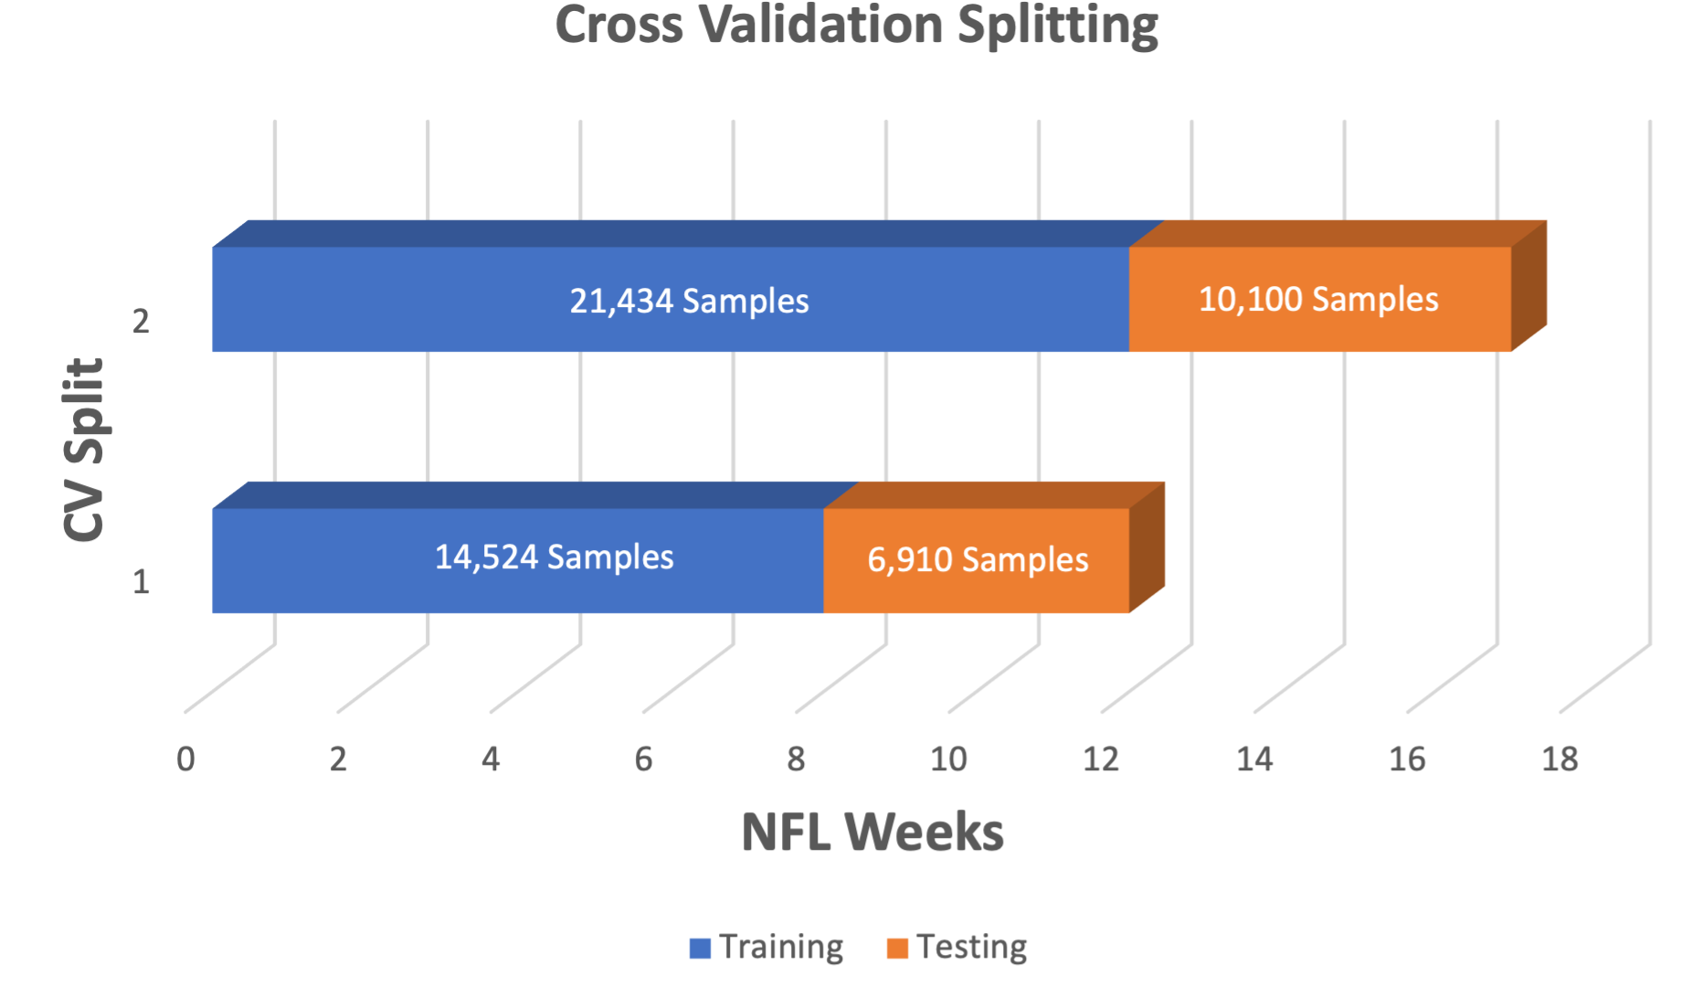
Cross-Validation Splitting
Training is used for teaching the model the patterns in the data
Weeks 1-8
Validation is used as unseen data used for evaluating hyperparameter combinations
Weeks 9-12
Testing is used for final performance reporting
Retrain candidate models weeks 1-12
Final test on weeks 13-17

Slide 13
Exploratory Analysis – Response
Important to understand distribution of the response in various cross-validation folds
Class Imbalance
Consistency
Distribution is “slightly imbalanced” in favor of passes over runs
No sampling methods necessary
The distribution remains consistent over the three folds
Training data is a good representation of the unseen samples
Fold | % Pass | % Run
Train | 59.50 | 40.50
Validation | 60.01 | 39.99
Test | 59.01 | 40.99

Slide 14
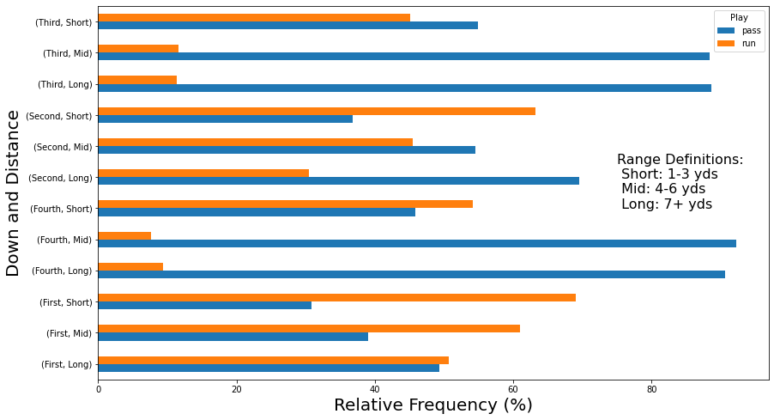
Exploratory Analysis – Features
Play call frequency by down and distance
Runs favored over passes on 1st, 2nd and short, and 4th and short
Large disparities of passes over runs for 3rd/4th and 4+ yards, 2nd and long
More passes on third and short
Riskier option with 2 plays left (pass)
Safer option with 1 play left (run)

Slide 15
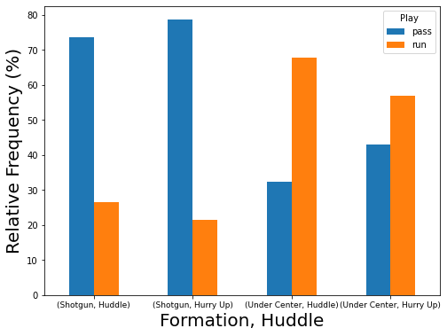
Exploratory Analysis – Features
Play call frequency by formation and huddle
Passes much more frequent from the shotgun formation
Slightly more frequently when also using the hurry up offense
Runs more common under center
Suspected it is more common to run when using hurry up under center when time is not a factor

Slide 16
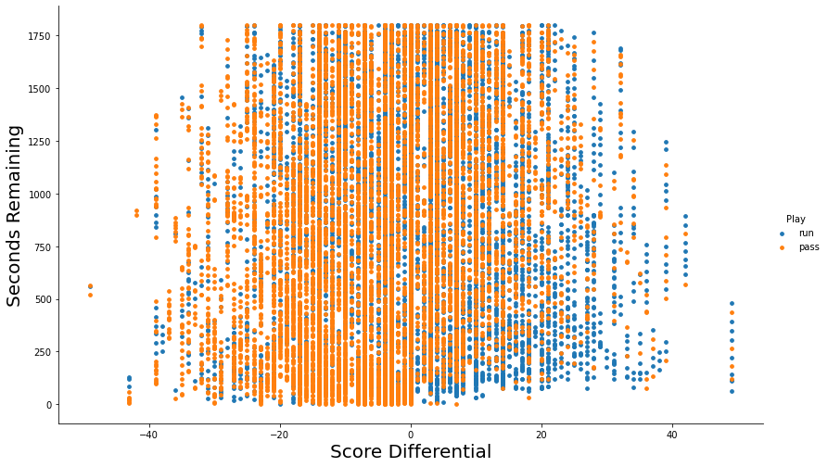
Exploratory Analysis – Features
Play call by score differential and seconds remaining
Passes much more frequent down by 0-20 points with less then 500 seconds remaining
Runs more common than usual up by 0-30 points in this same time window

Slide 17
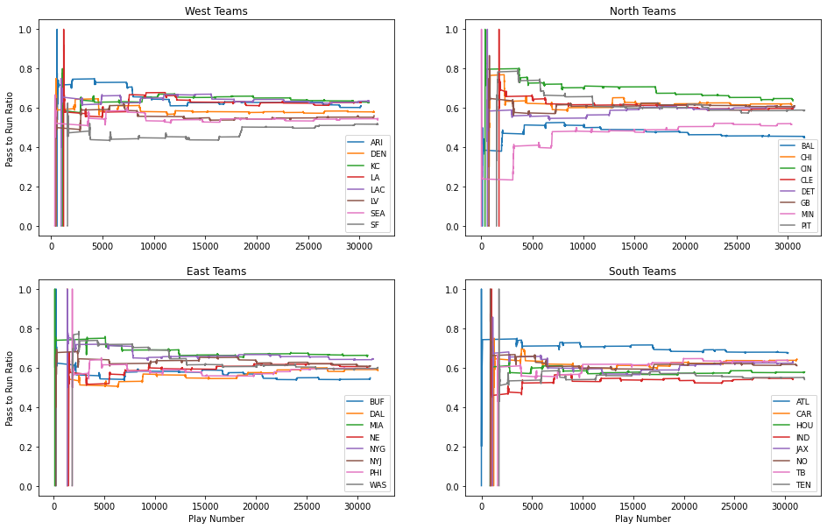
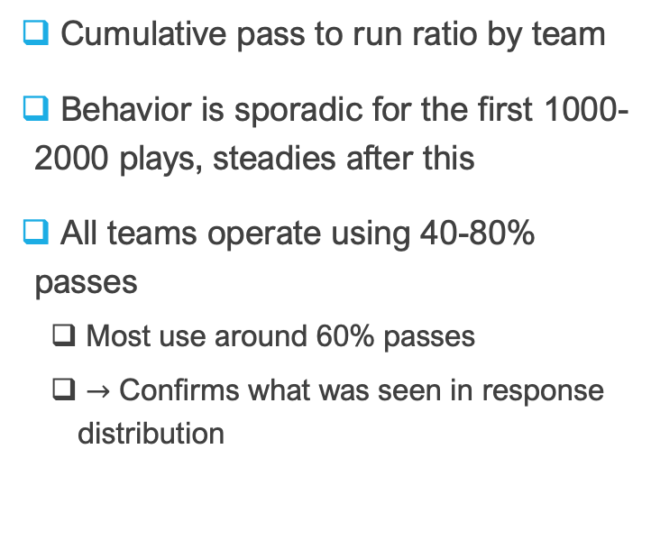
Exploratory Analysis – Features
Cumulative pass to run ratio by team
Behavior is sporadic for the first 1000-2000 plays, steadies after this
All teams operate using 40-80% passes
Most use around 60% passes
$→$ Confirms what was seen in response distribution

Slide 18


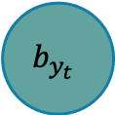
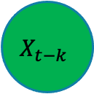
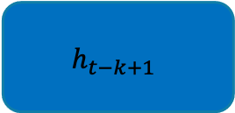
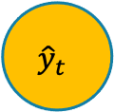
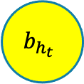
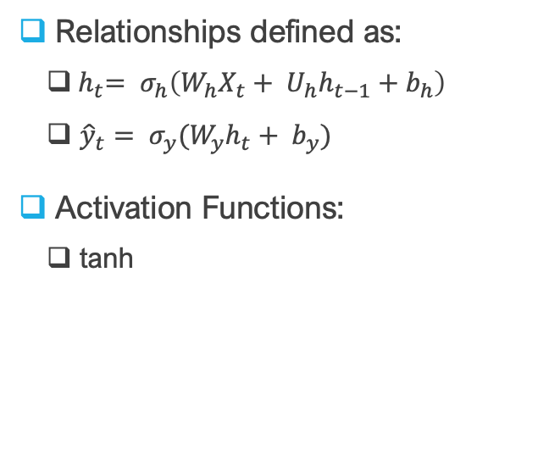

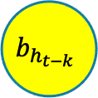
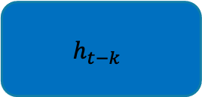

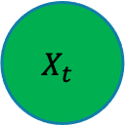


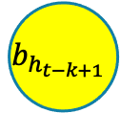
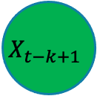


Model Details – RNNs
$${\hat{y}}_{t}$$
Relationships defined as:
${ h}_{t}= σ_{h}\left(W_{h}X_{t}+ U_{h}h_{t−1}+b_{h}\right)$
${\hat{y}}_{t}= σ_{y}(W_{y}h_{t}+ b_{y})$
Activation Functions:
tanh
$$b_{y_{t}}$$
$$W_{y_{t}}$$
$$h_{t−k}$$
$$h_{t−k+1}$$
$$h_{t}$$
…
$$U_{h_{t−k}}$$
$$U_{h_{t−k+1}}$$
$$U_{h_{t}}$$
$$b_{h_{t−k}}$$
$$W_{h_{t−k}}$$
$$b_{h_{t−k+1}}$$
$$W_{h_{t−k+1}}$$
$$b_{h_{t}}$$
$$W_{h_{t}}$$
$$X_{t−k}$$
$$X_{t−k+1}$$
$$X_{t}$$

